Slide 1

Phylolinguistics part 2
Benedict King, MPI EVA

Slide 2
Learning goals
Gain an overview of some more advanced methods of language phylogenetics
Phylogenetics with ancient languages
Phylogenetics with language contact models
Learn some of the ways in which trees can be used in language science
Ancestral state reconstruction
Correlated traits
Diversification analyses
Phylogeography

Slide 3
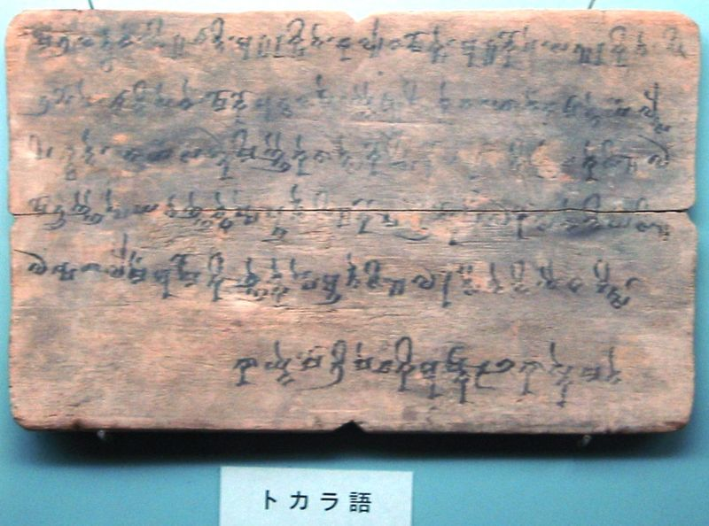
Advanced phylolinguistics 1: ancient languages
Usually preserved as ancient text
Provide an alternative way to date phylogeny
Ancient languages are often included as part of the data matix, often with missing data
Tocharian B

Slide 4
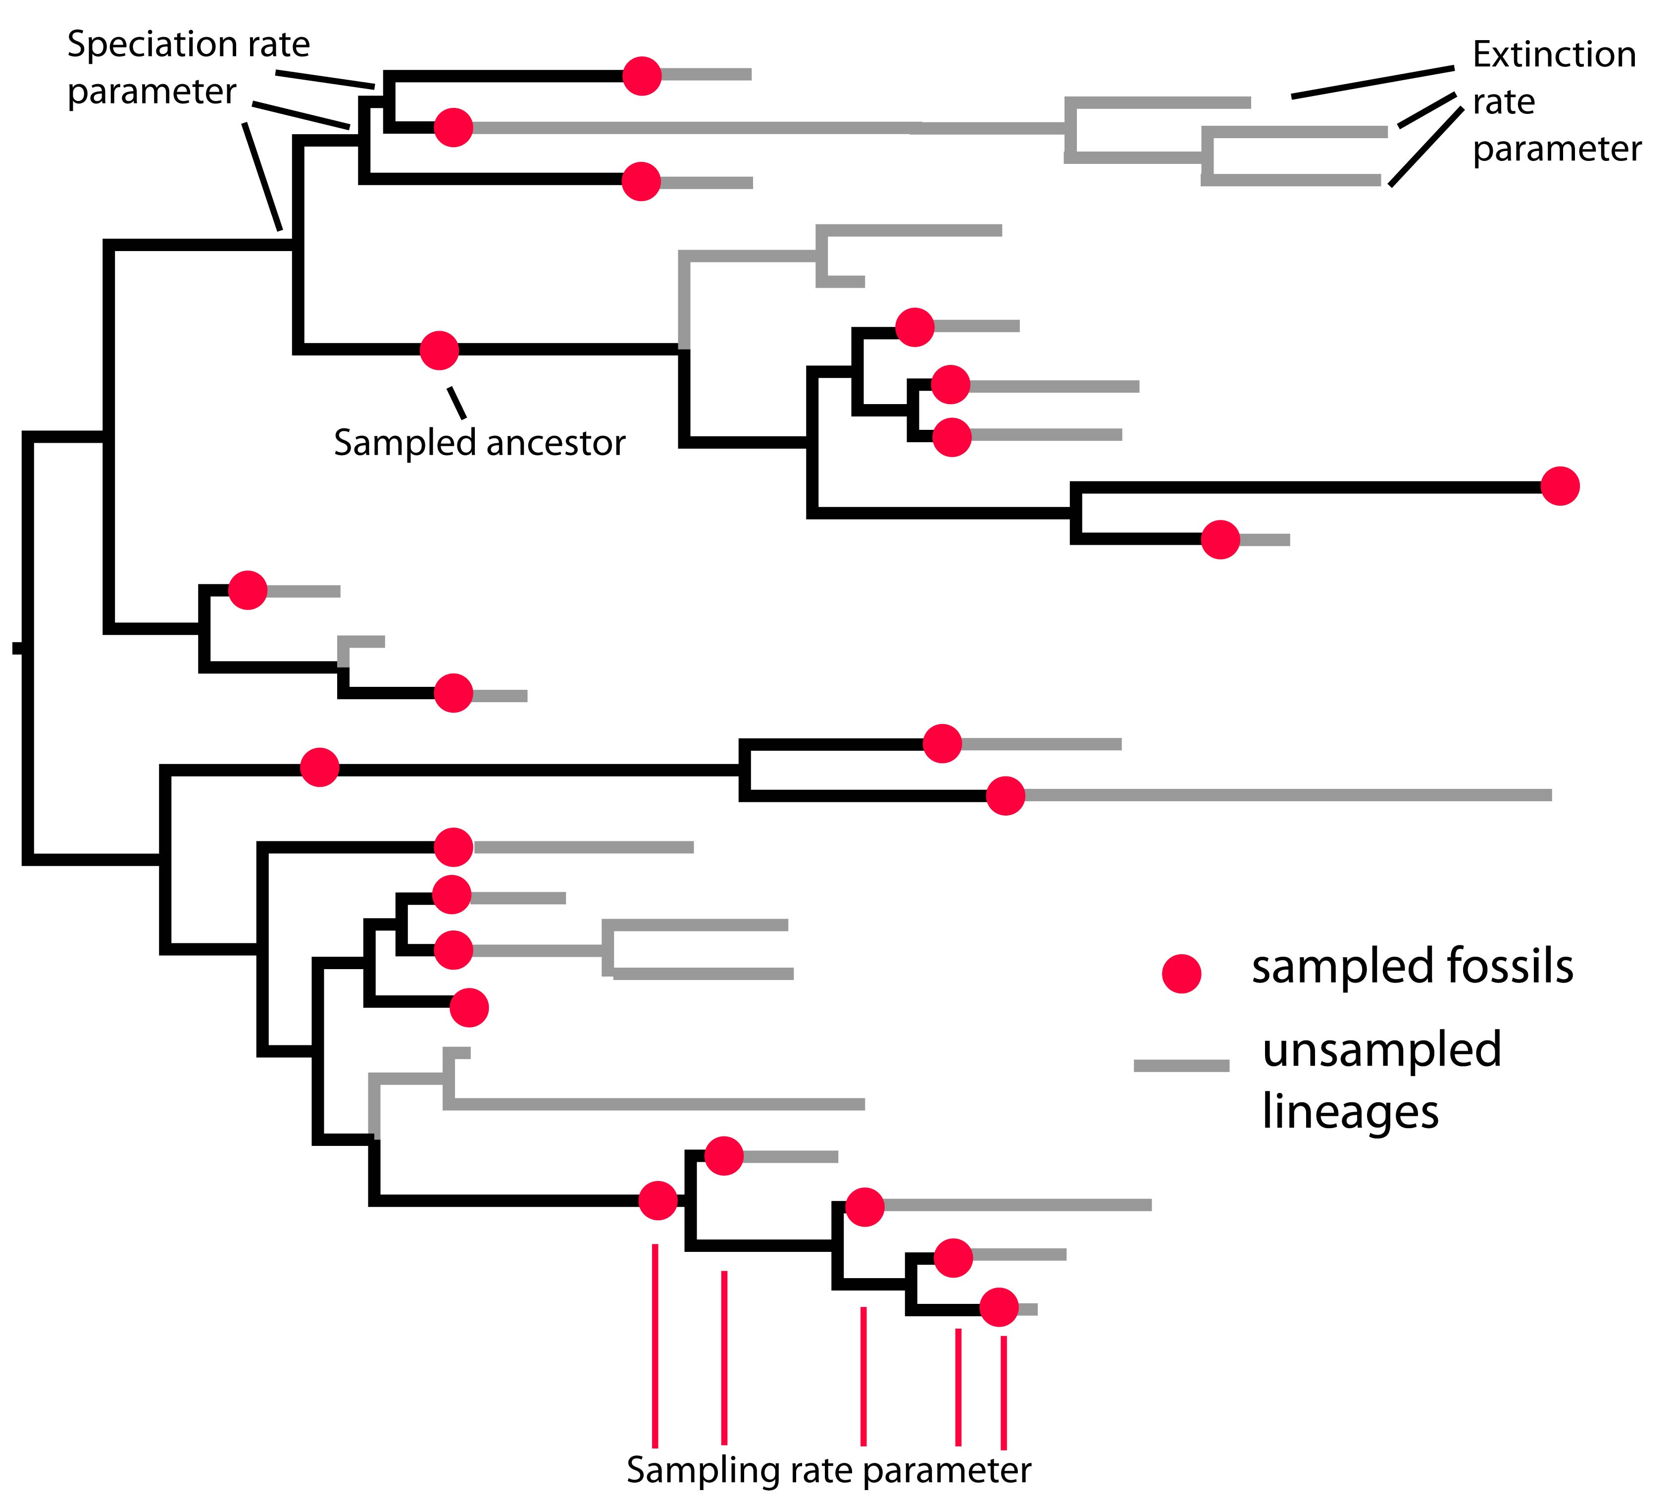
Including ancient languages in the tree model
Include an additional parameter in the tree model: the “sampling rate”
This determines how often ancient languages are preserved

Slide 5
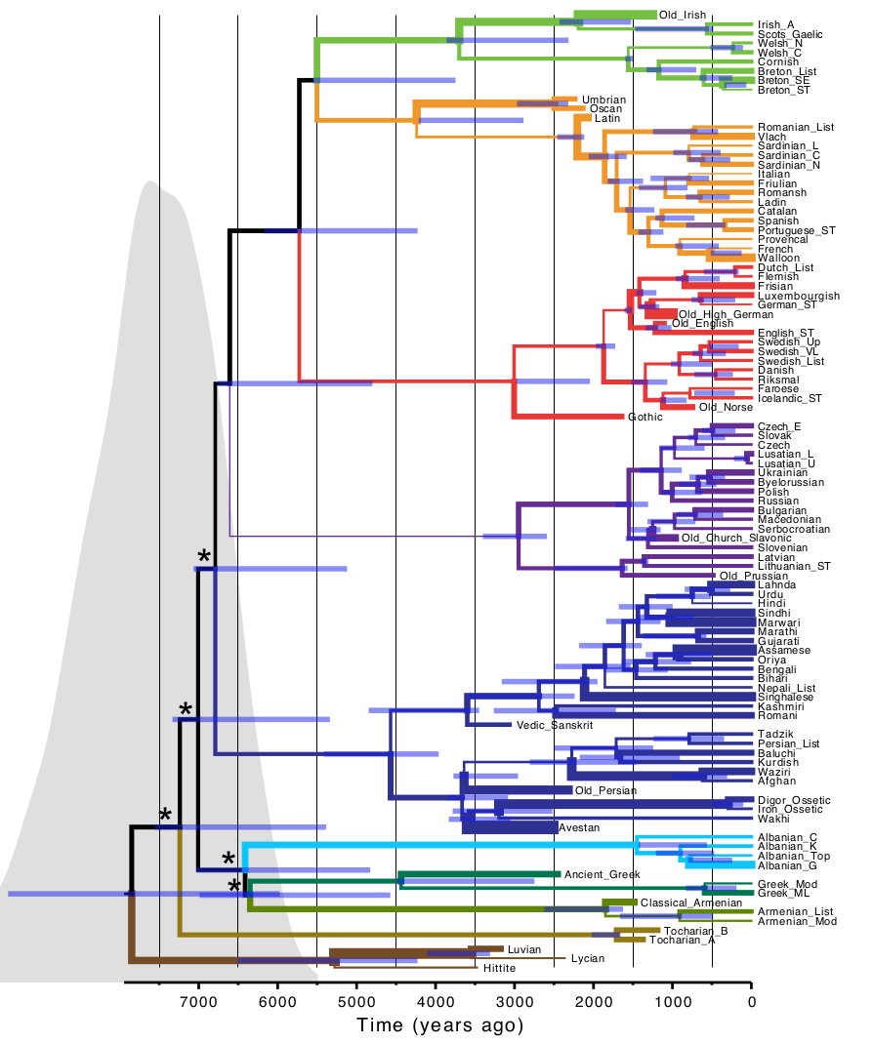
Bouckaert et al. 2012
Indo-European phylogeny with ancient languages
IELEX dataset

Slide 6
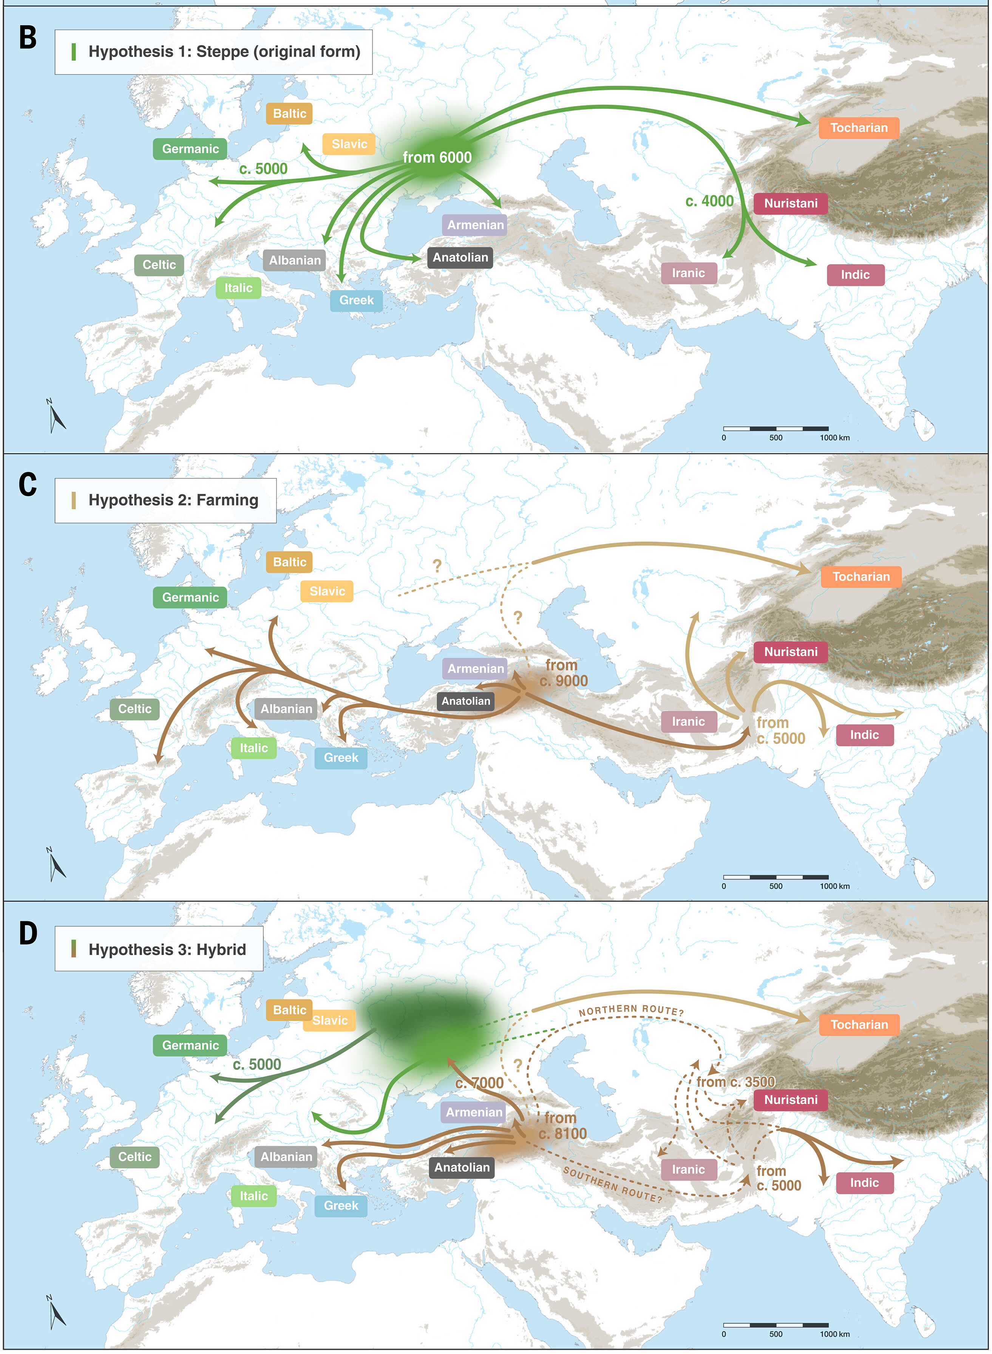
From Heggarty et al. 2023

Slide 7
Ancient languages as direct ancestors
Latin
Italian
Italian
Latin
French
French
Spanish
Spanish

Slide 8
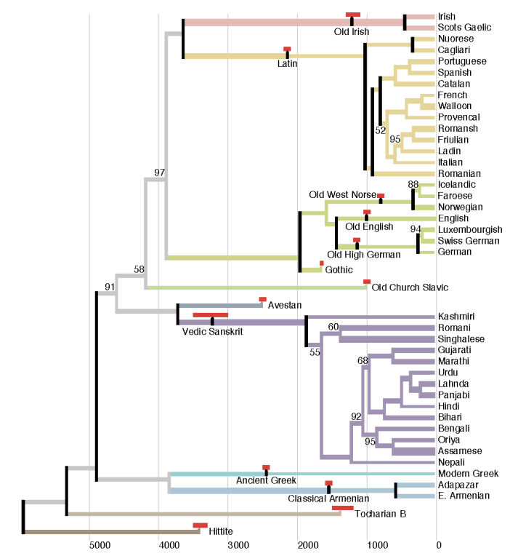
Chang et al 2015: Ancestry constrained analysis
Ancient languages forced to be direct ancestors
Produced much younger dates for Indo-European
Same IELEX dataset

Slide 9
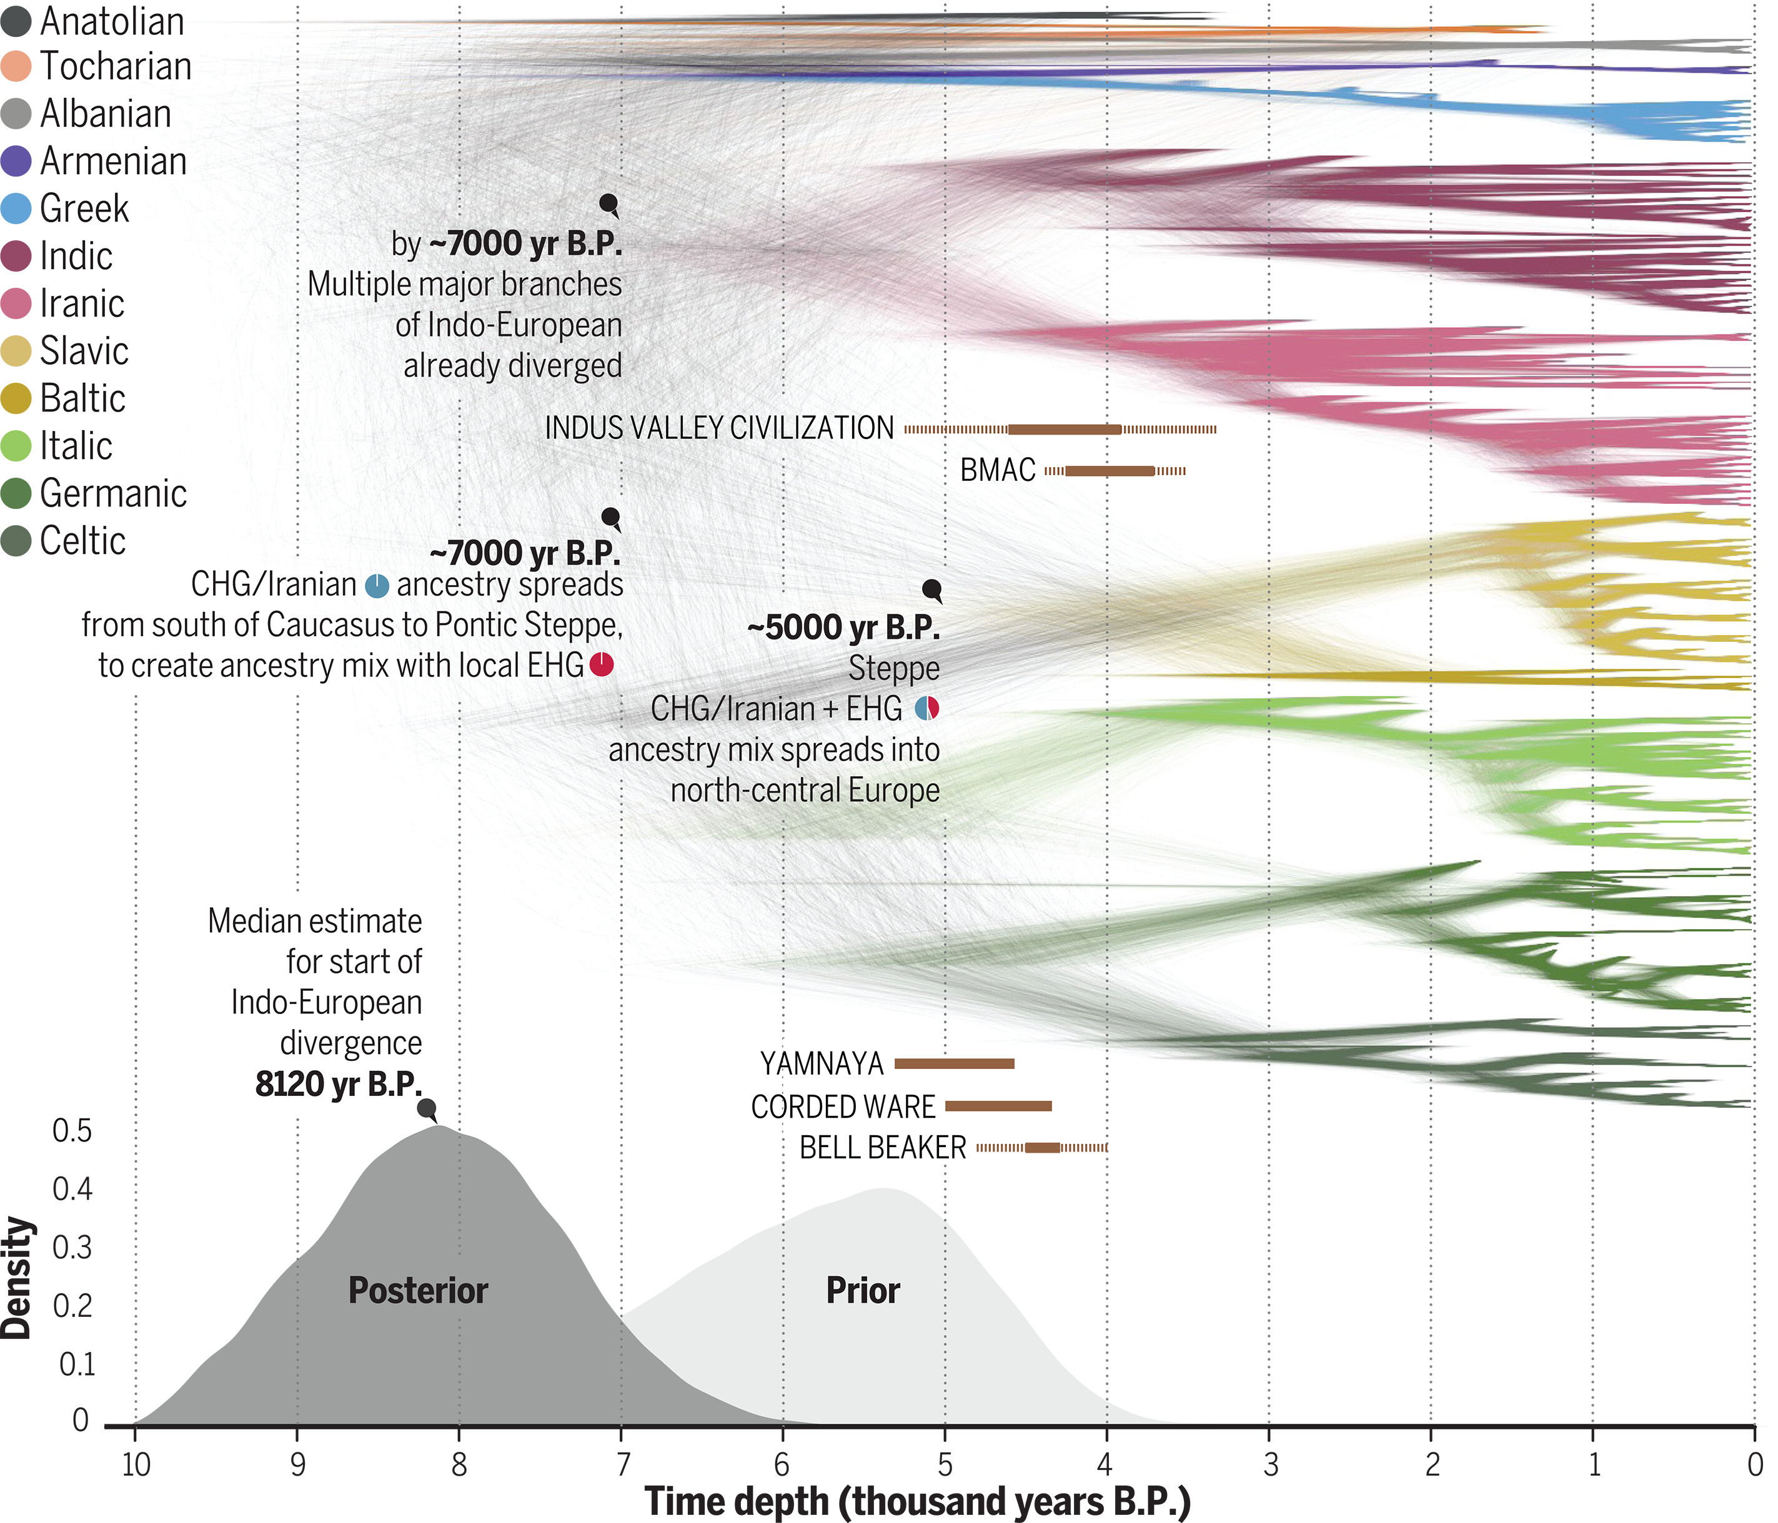
Heggarty et al. (2023) Sampled ancestors
Let the data decide if ancient languages are directly ancestral or not
New IECoR dataset

Slide 10
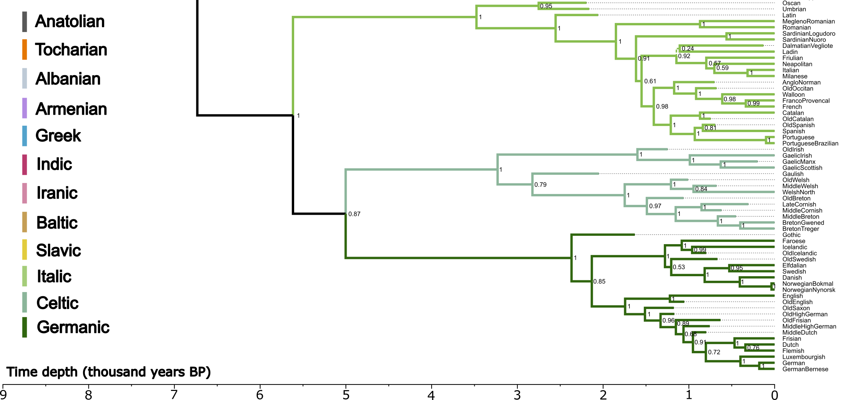
Heggarty et al. (2023) Sampled ancestors

Slide 11
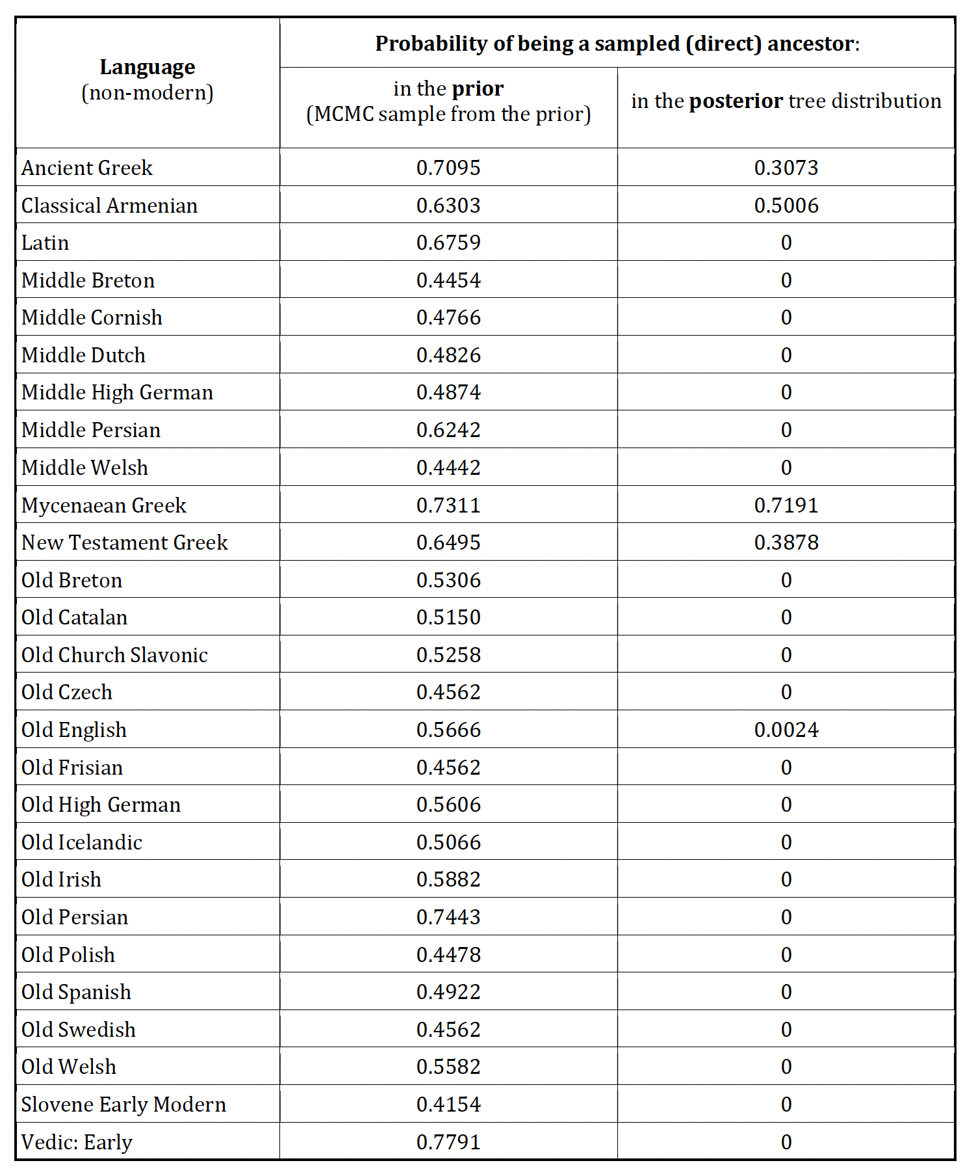
Few ancient languages found to be sampled ancestors

Slide 12
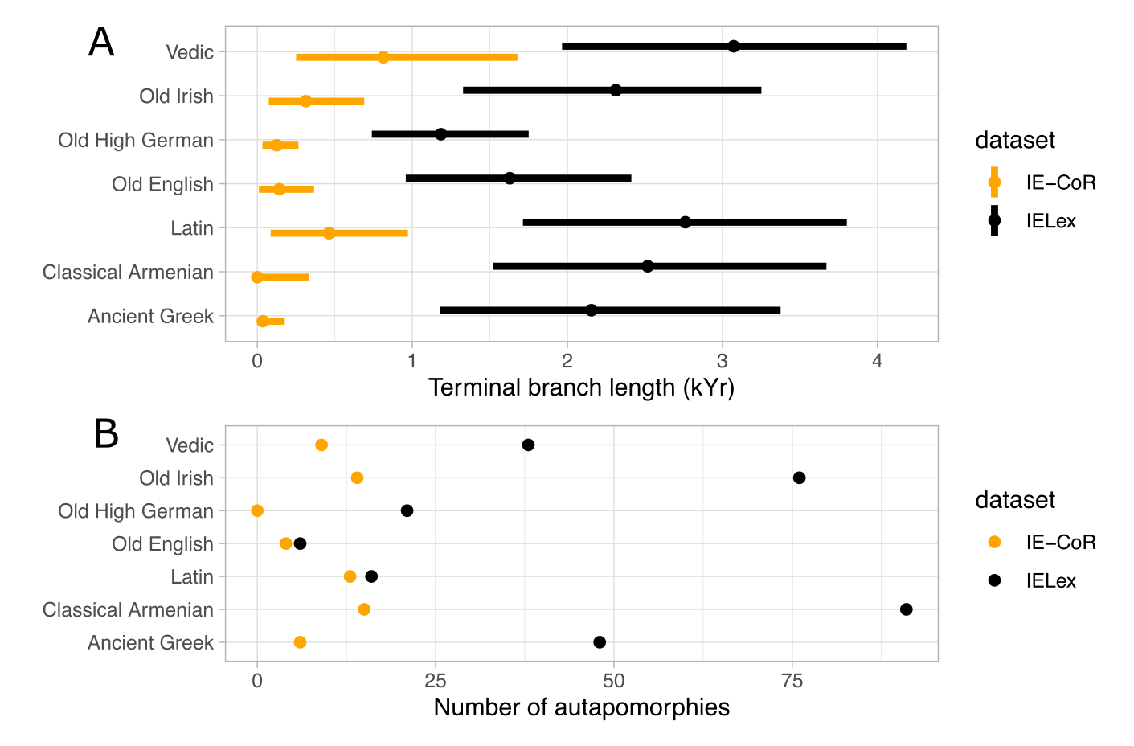
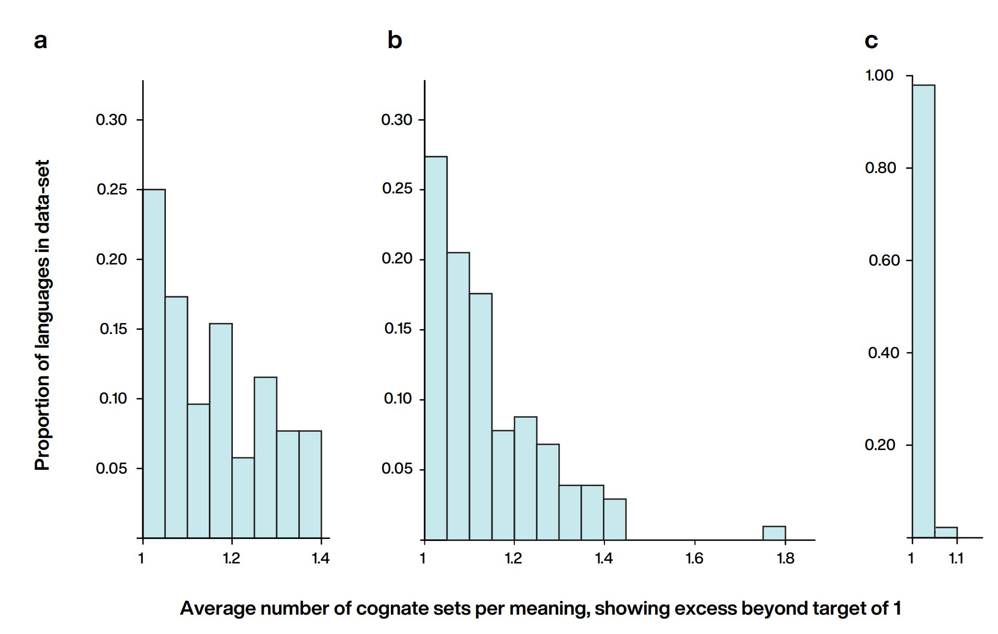
Few ancient languages found to be sampled ancestors
IELEX
IE-CoR

Slide 13
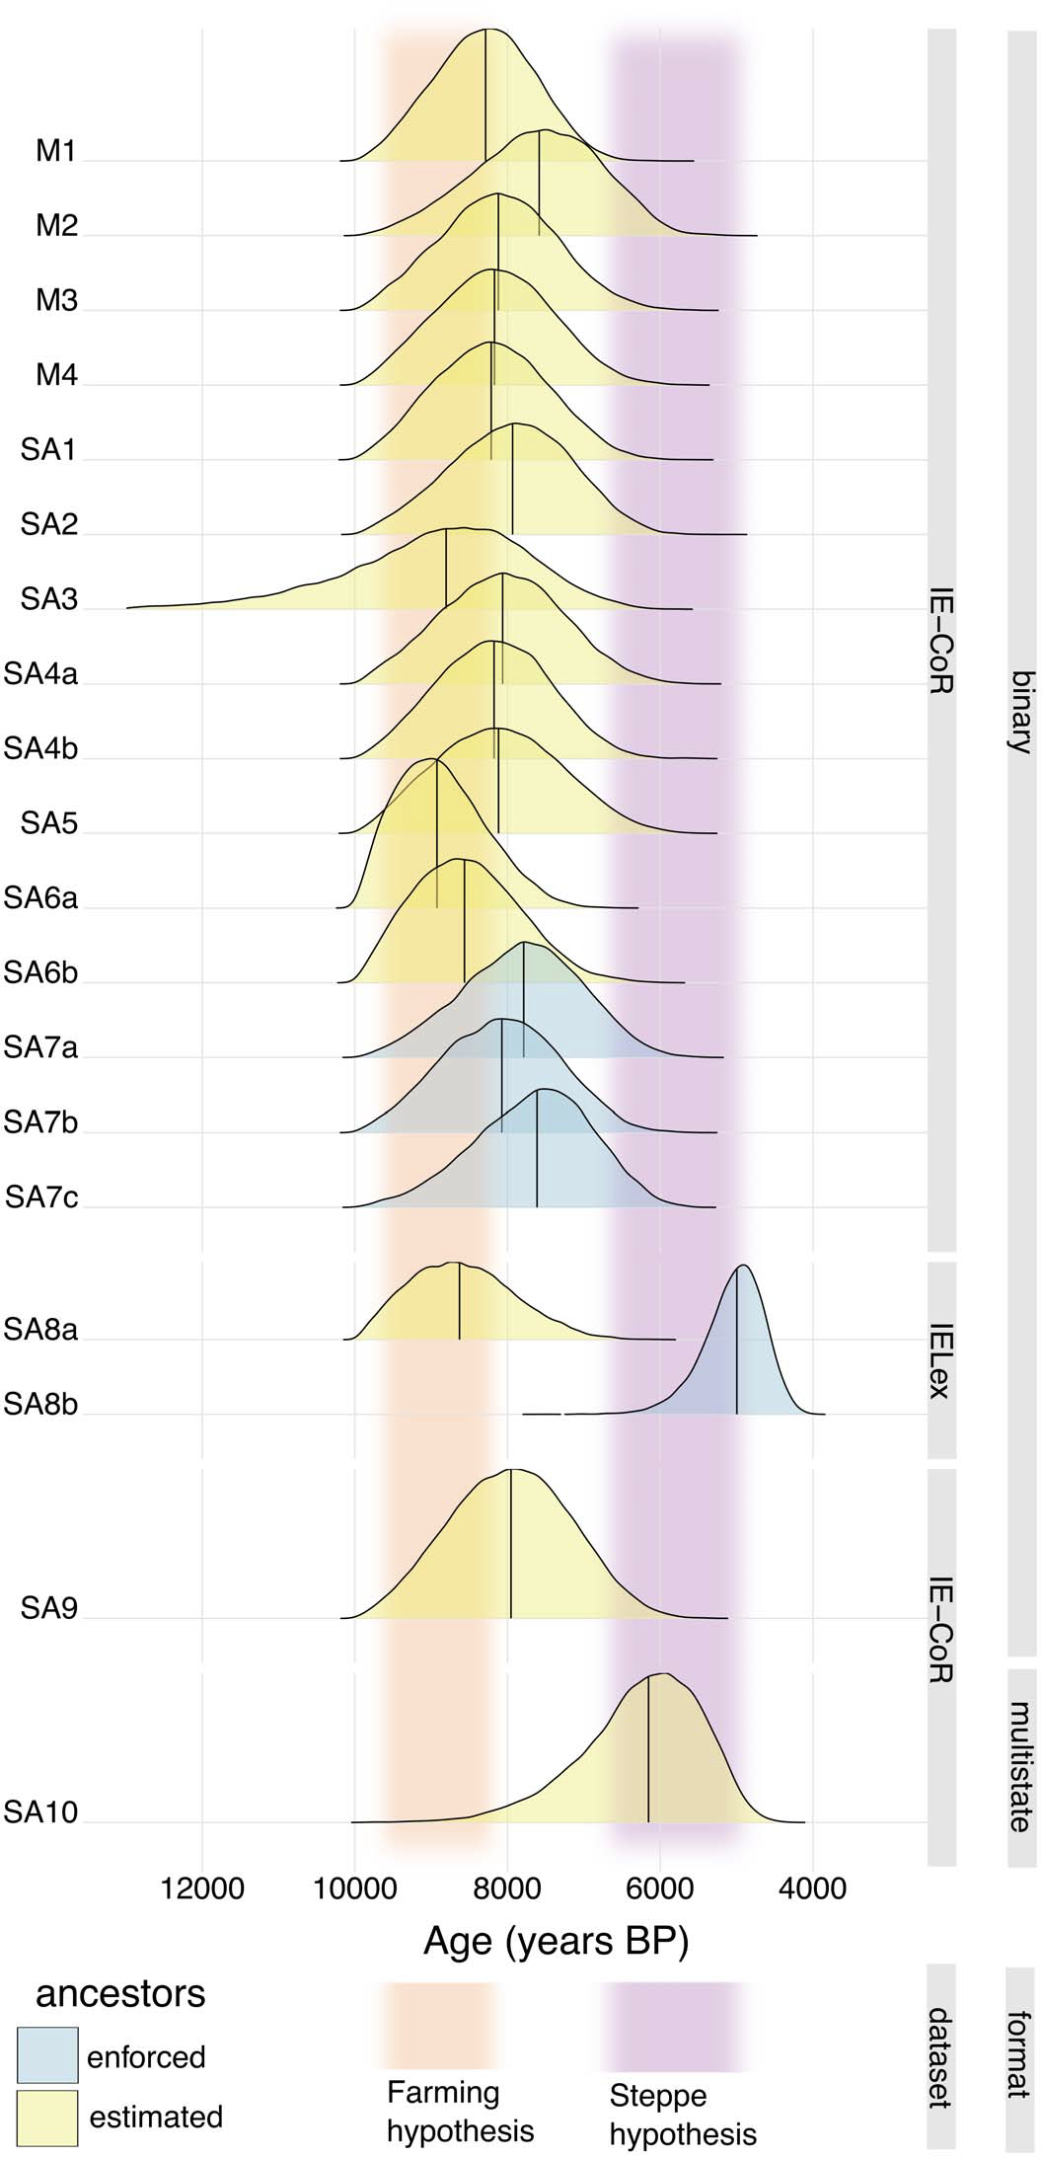
Younger dates for Indo-European ONLY when enforcing ancestors AND using the IELEX dataset

Slide 14
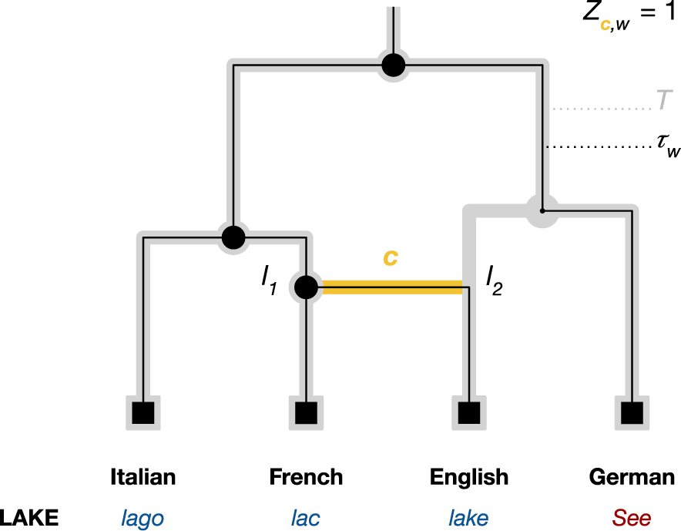
Advanced phylolinguistics 2: language contact
Adds “Contact edges” to the phylogenetic model
Borrowed words follow these contact edges rather than the tree
Neureiter et al. 2022

Slide 15
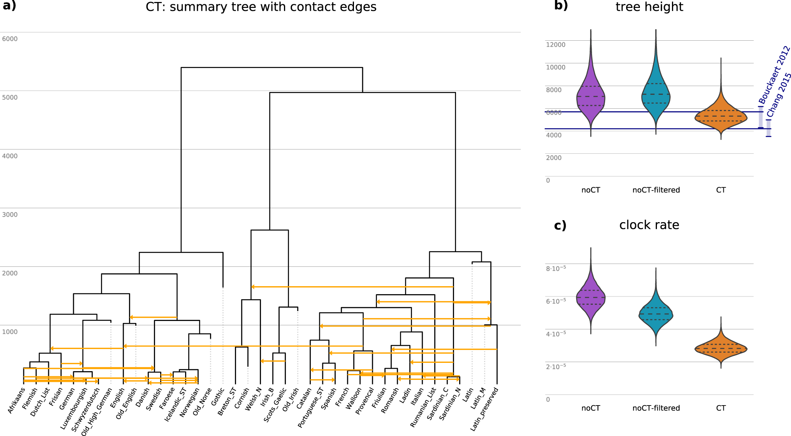

Slide 16
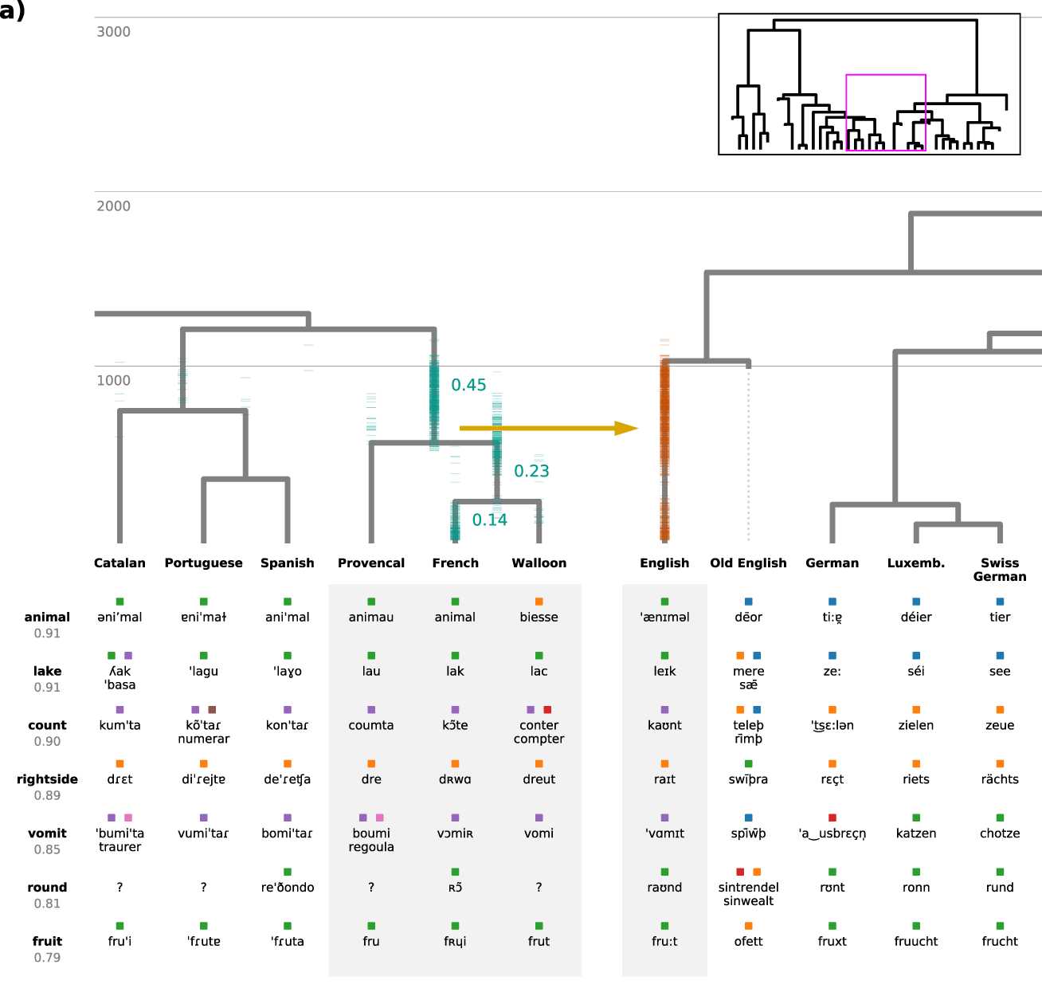

Slide 17
Part 2: Phylogenetic Comparative methods
Phylogenetic comparative methods (PCMs) use information on the historical relationships of lineages (phylogenies) to test evolutionary hypotheses
In practice: the tree or trees from the phylogenetic analysis are taken as the input for further analyses

Slide 18
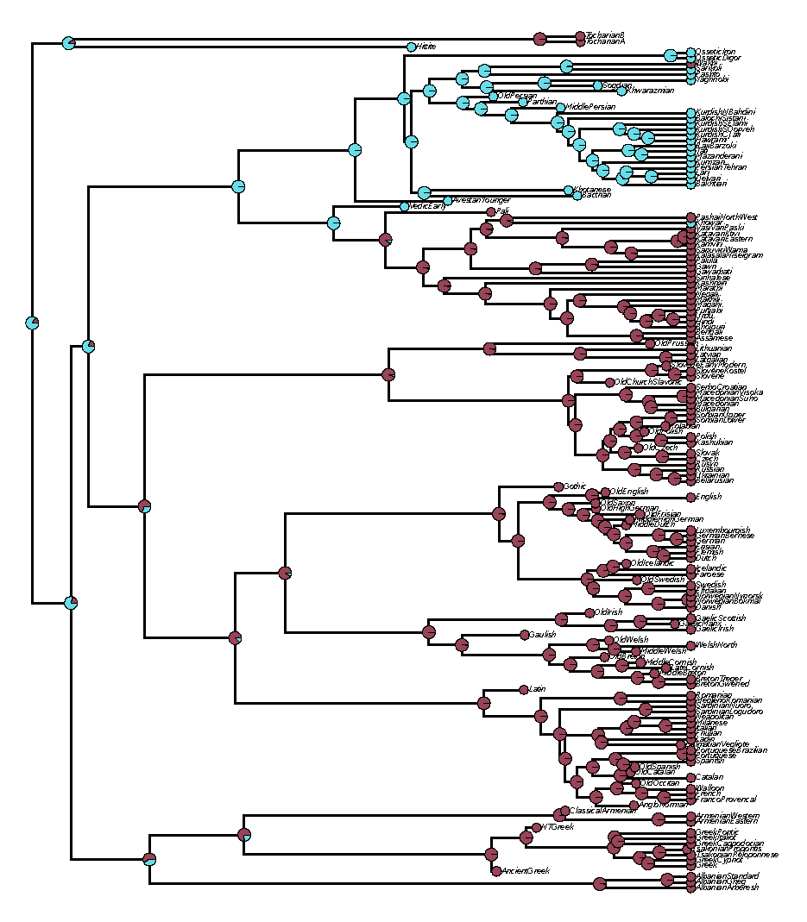
Ancestral state reconstruction
What was the condition at the ancestor (e.g. what was present in a proto-language)
When and how often did transitions occur

Slide 19
Parsimony ancestral state reconstruction

Slide 20
Maximum likelihood ASR
Branch lengths matter
Estimates a rate of evolution
Different models can be used
probabilistic

Slide 21
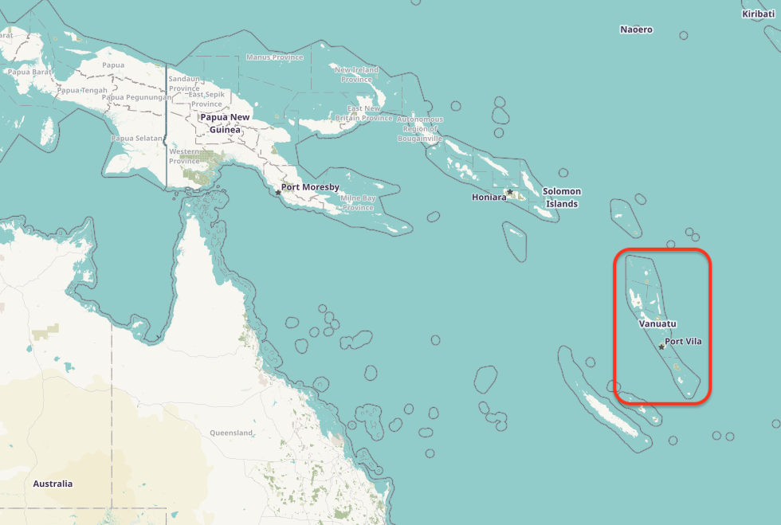
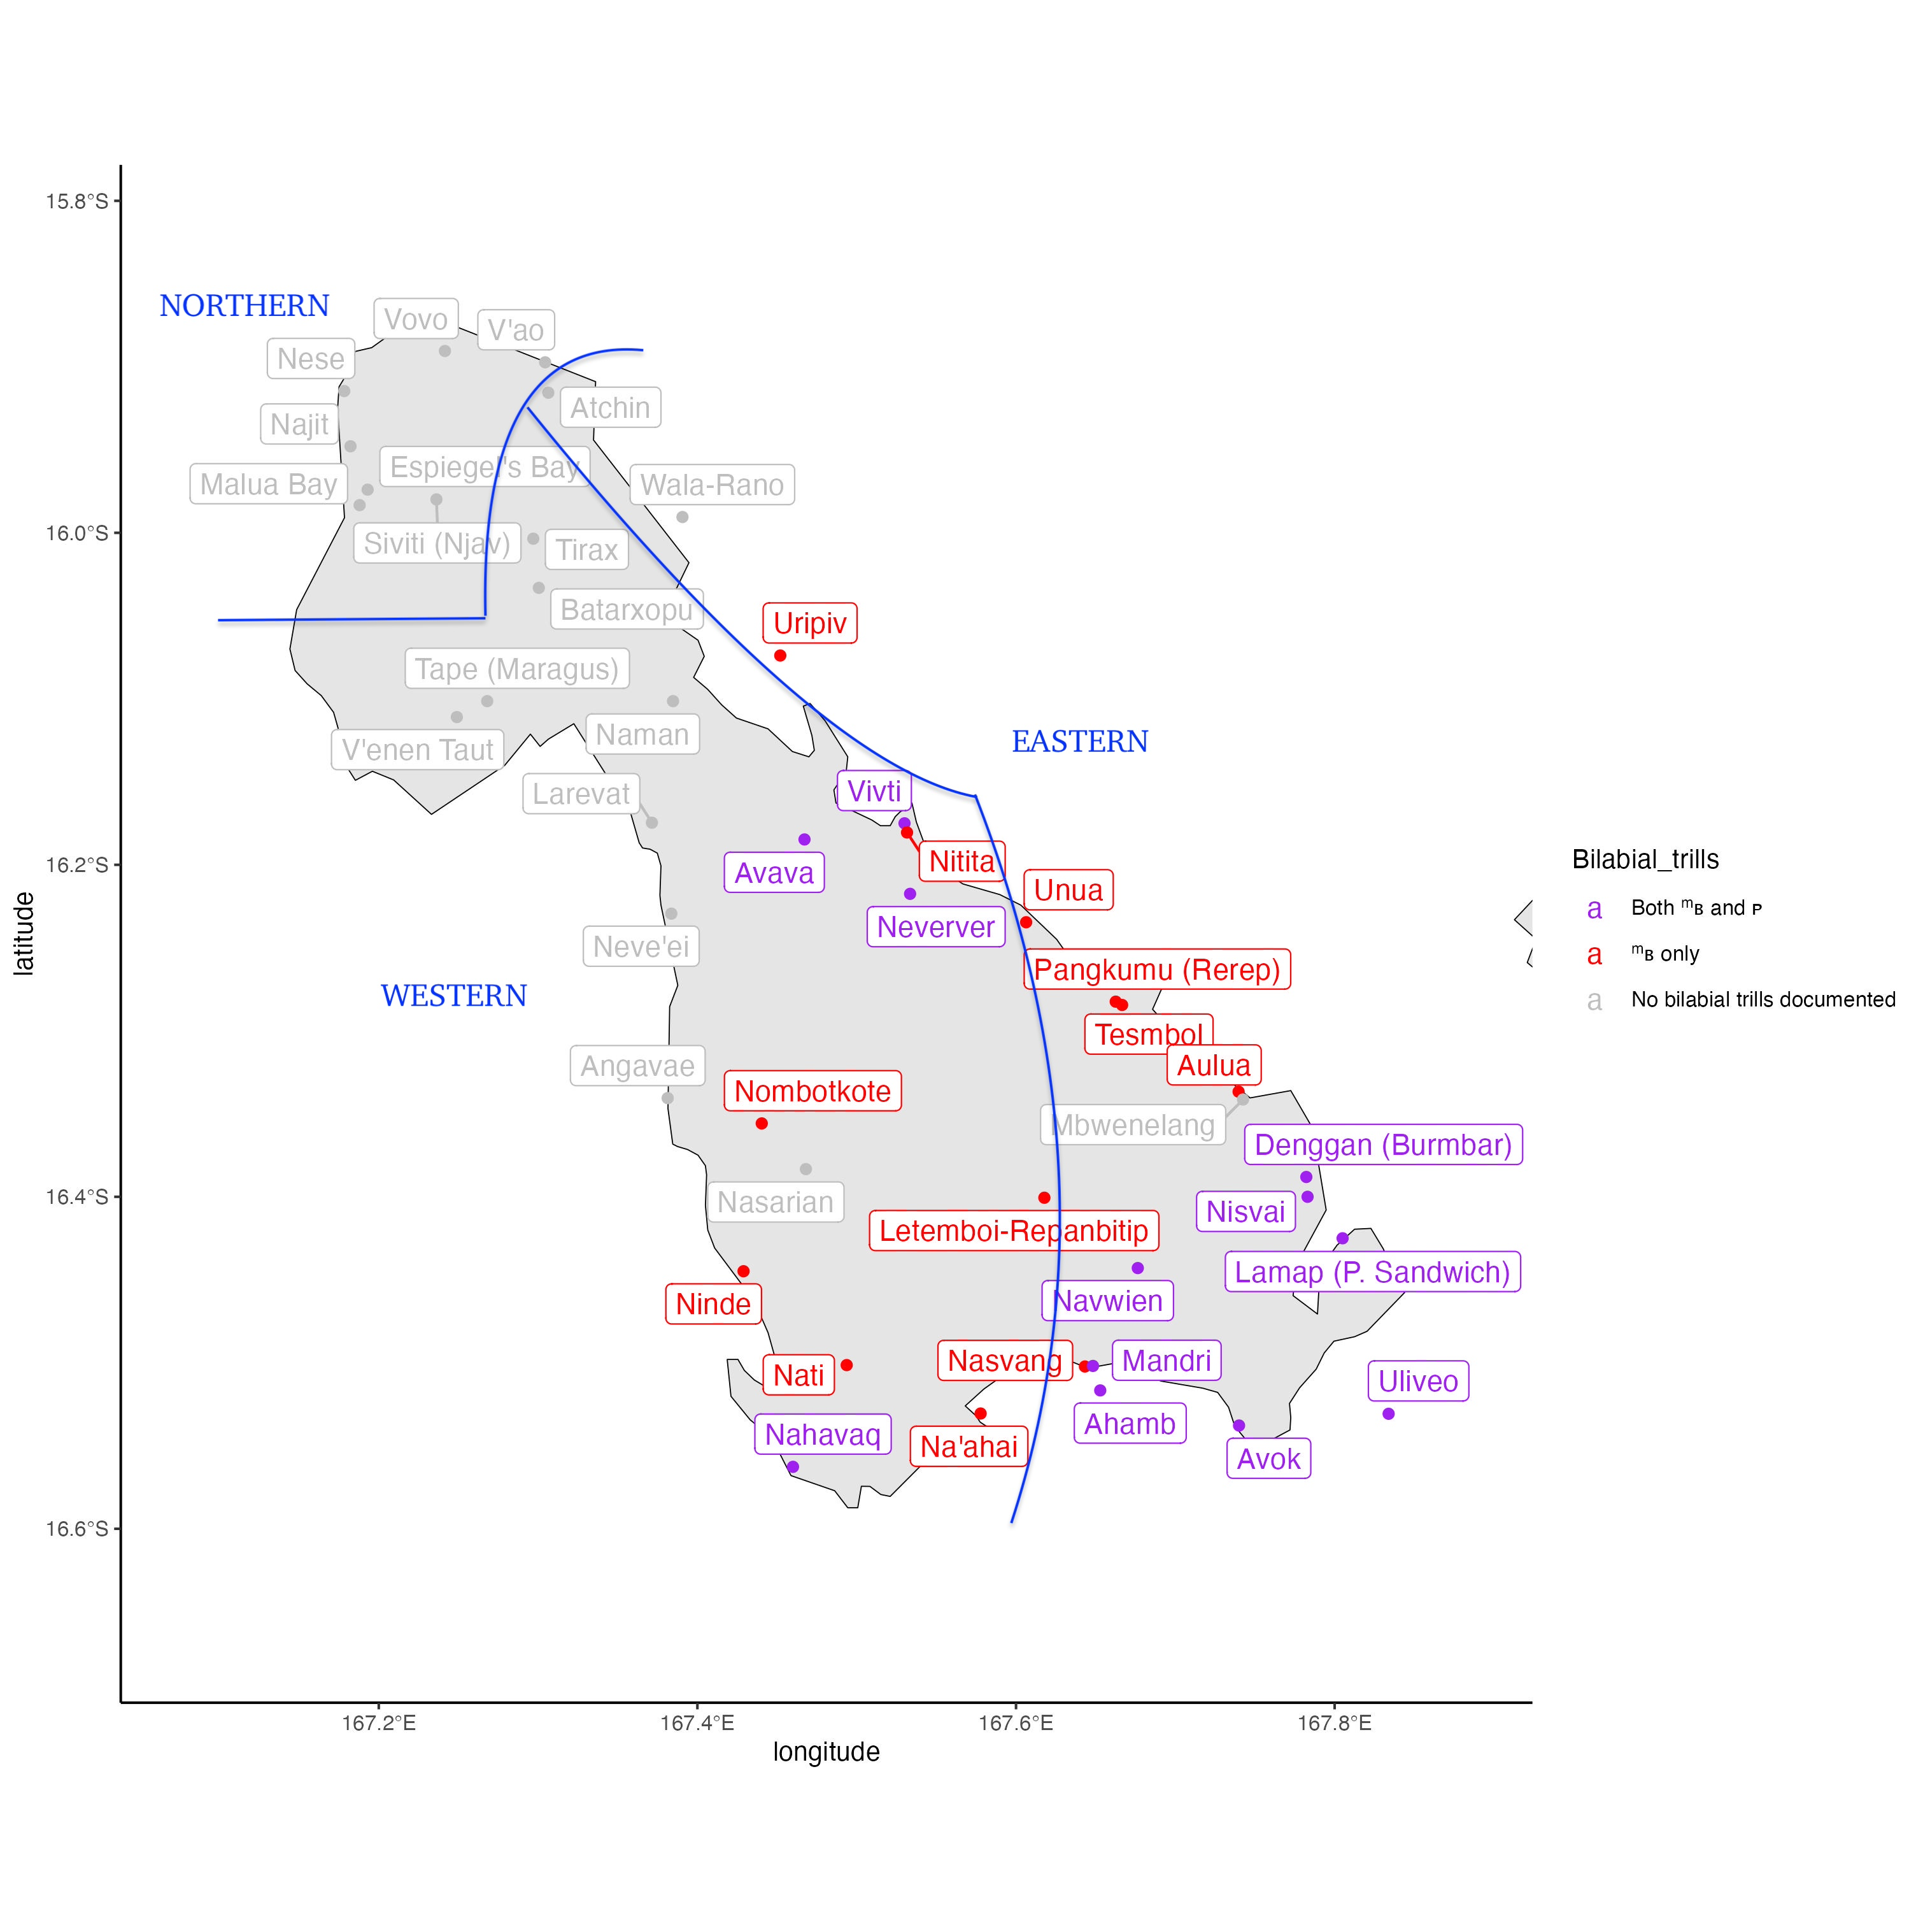
Case study of ancestral state reconstruction: Bilabial trills in the languages of Malekula

Slide 22
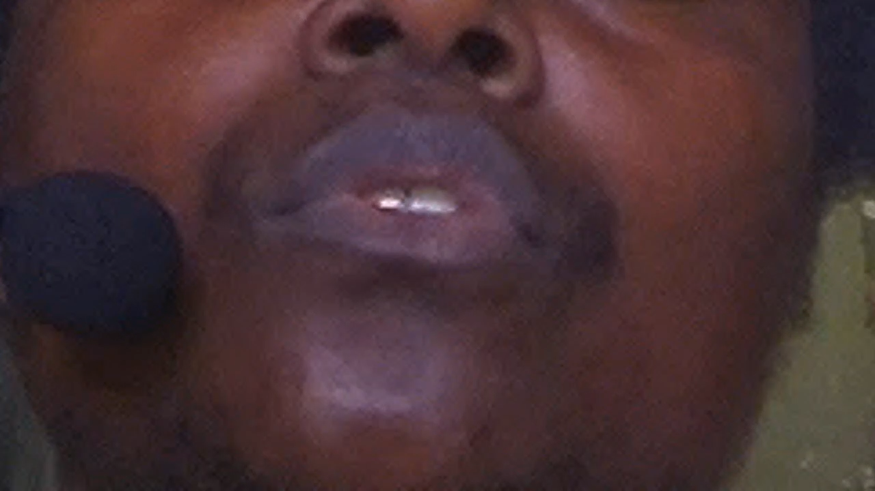
34-year-old female speaker of Ahamb (North-Central Vanuatu, Malekula)
[ᵐʙusi] ‘squeeze it’
[ŋaˈʙ̥us] ‘it blossoms’

Slide 23
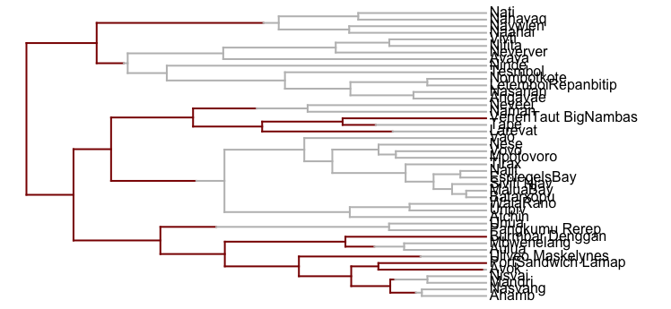
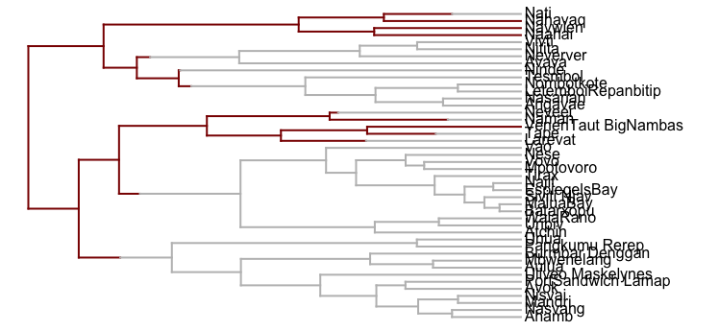
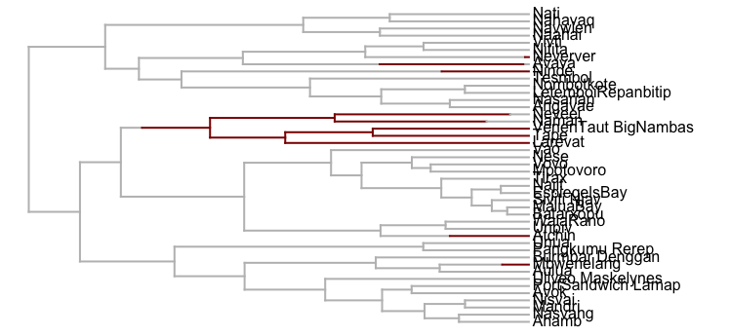
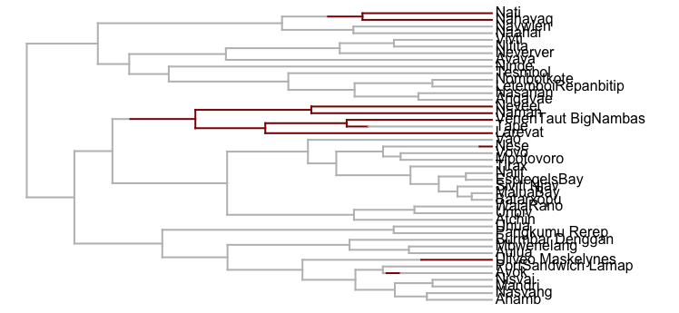
Two hypotheses to explain bilabial trills
Hypothesis 1
Early rapid origin of trills
Gradually lost through time in different lineages
Hypothesis 2
Trills spread gradually
Dynamic evolution: trills lost, gained and borrowed

Slide 24
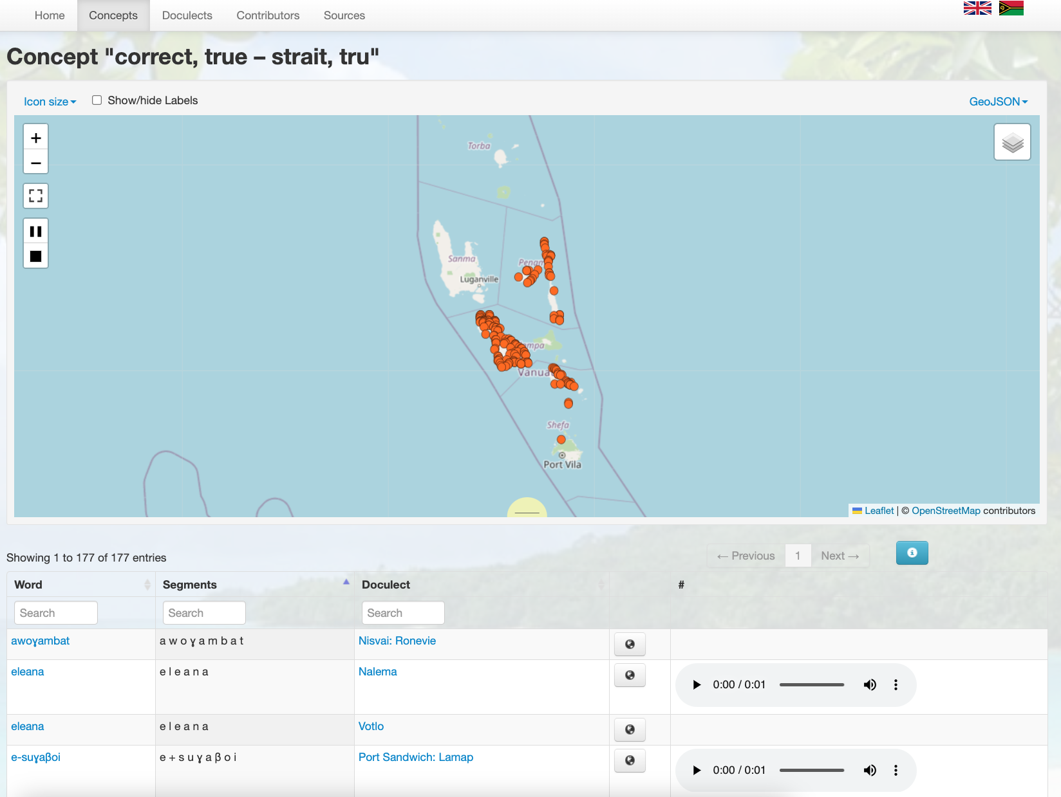
Vanuatu Voices database
Varieties: 214
Concepts: 426
Lexemes: 39,002

Slide 25
Cognate coded trills data from Vanuatu Voices
Language | Lexeme | Cognate set
Mandri | -saᵐʙ
Mbwenelang | -samb
Naahai | -hat
Nahavaq | -het
Najit | -sat
Naman | –is
Nasarian | -sej
Nasvang | samb
0
Trills present
1
Trills cognate set
Trills absent
2
2
2
other cognate sets
3
2
1
Trills absent

Slide 26
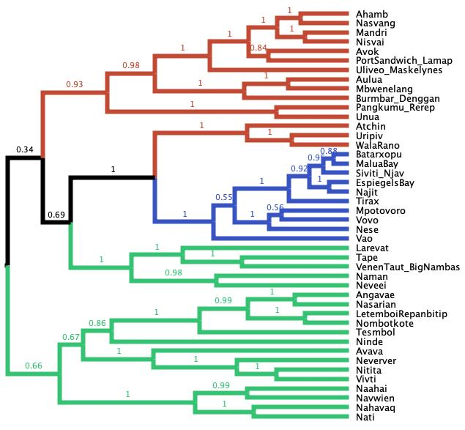
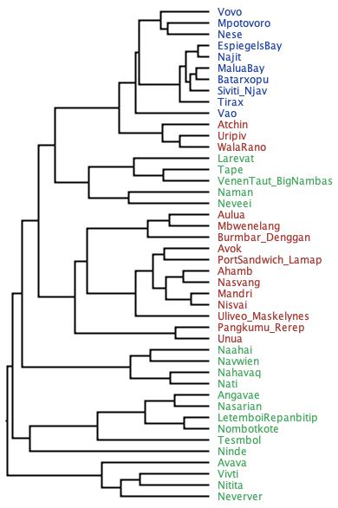
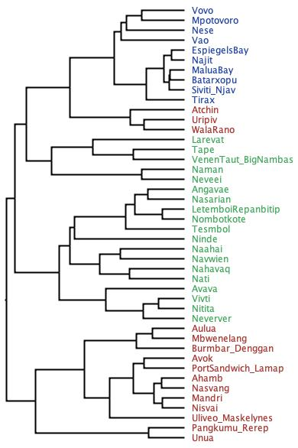
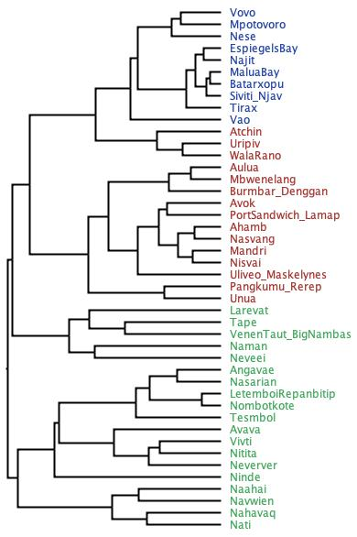
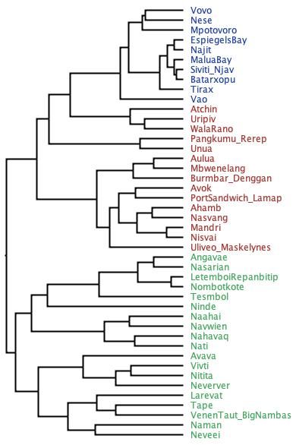
Step 1: phylogenetic tree sample

Slide 27
t parameter is the stable frequencies
It describes overall biases in gain and loss of trills
t[0] = 0.05
fast
t[1] = 0.95
t[0] = 0.5
equal
t[1] = 0.5
mBu
mbu
mBu
mbu
slow
equal
Hypothesis 1
Hypothesis 2

Slide 28
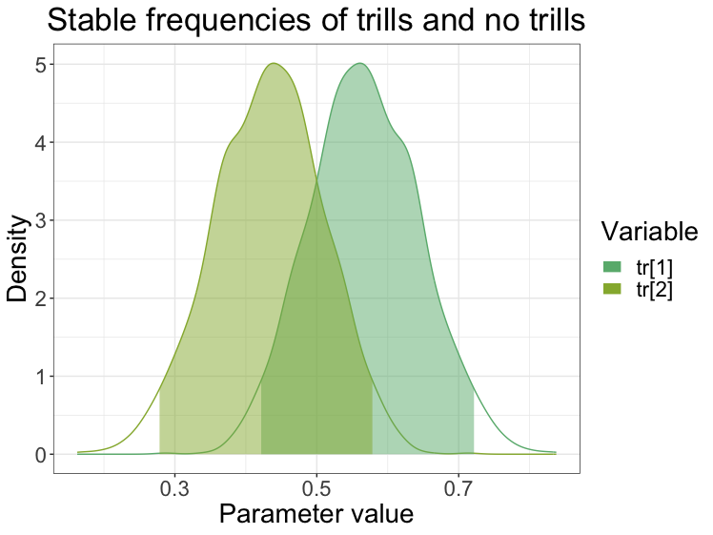
Model testing supports hypothesis 2
Worst model. Bayes factor -25.5
Best model
Bayes factor -1.5
fast
equal
0 < t[0] < 1
?
0 < t[1] <1
t[0] = 0.05
t[1] = 0.95
t[0] = 0.5
t[1] = 0.5
mBu
mbu
mBu
mbu
mBu
mbu
slow
equal
?
Freely estimated
Hypothesis 1
Hypothesis 2

Slide 29
Ancestral state reconstruction of bilabial trills in Malekula languages

Slide 30
Bilabial trills conclusions
Bilabial trills are frequently gained and lost in Malekula, despite being rare worldwide
They spread through the lexicon gradually
The dynamic evolution of the trills may be due to identity attachment

Slide 31
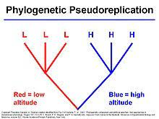
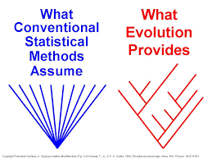
Phylogenetic correlation

Slide 32
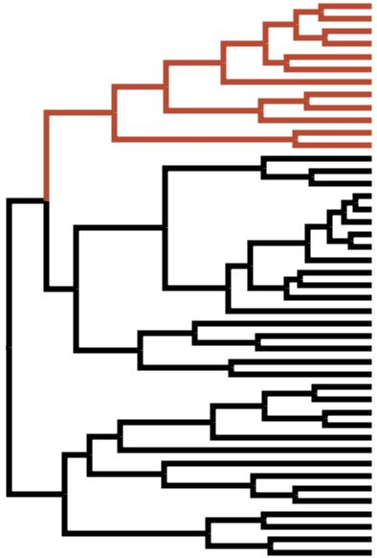
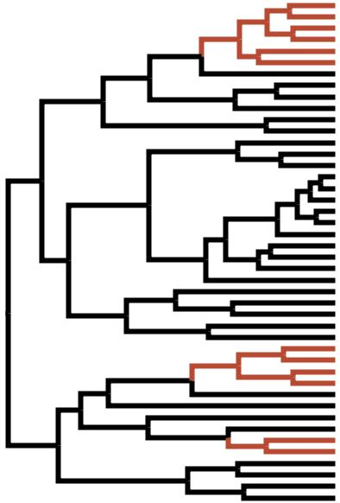
Phylogenetic correlation: discrete traits
Trait 1
Trait 2
Trait 1
Trait 2
1 correlated transition
Weak evidence
3 correlated transitions
Strong evidence

Slide 33
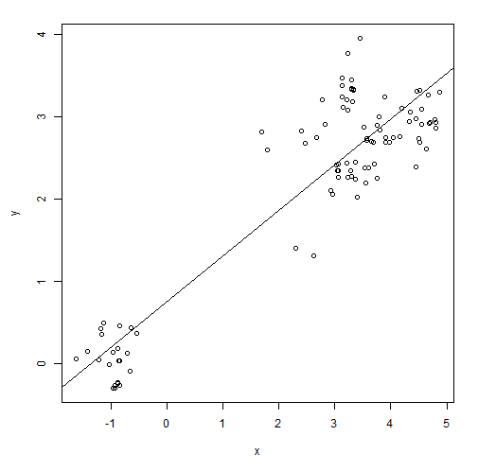
Phylogenetic correlation, continuous traits

Slide 34
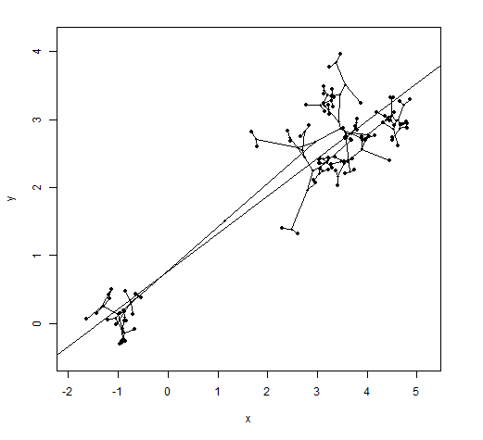

Slide 35
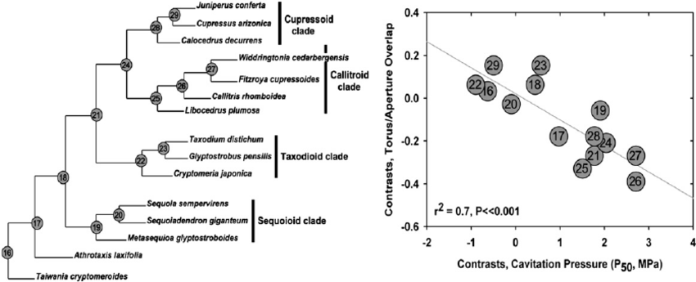
Independent contrasts

Slide 36
Phylogenetic models of trait dependence
Independent evolution
Separate traits
Independent evolution
Combined traits
Dependant evolution
Combined traits

Slide 37
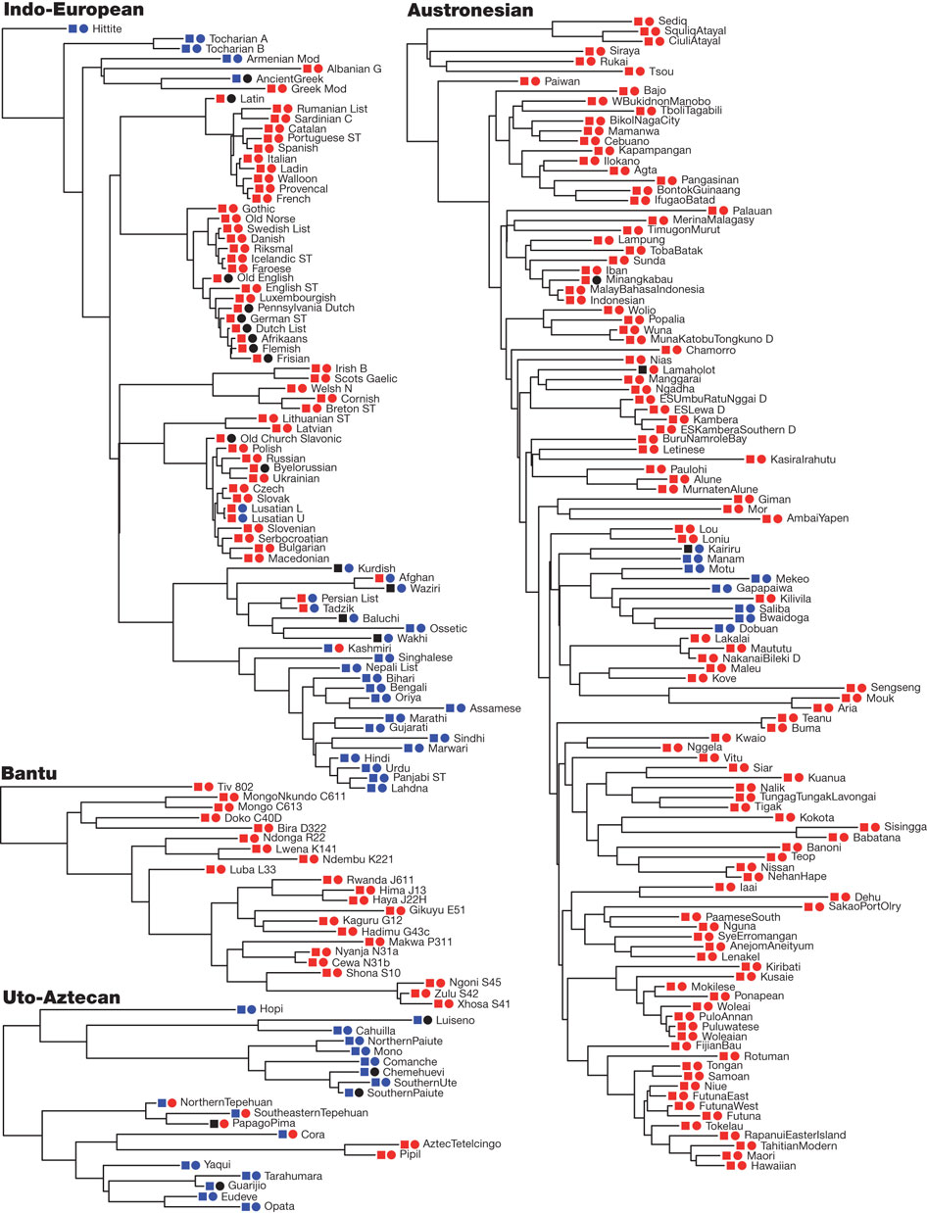
Testing correlation between word order features
Two word-order features plotted onto maximum clade credibility trees of four language families.
Squares represent order of adposition and noun; circles represent order of verb and object
M Dunn et al. Nature 000, 1-4 (2011) doi:10.1038/nature09923

Slide 38
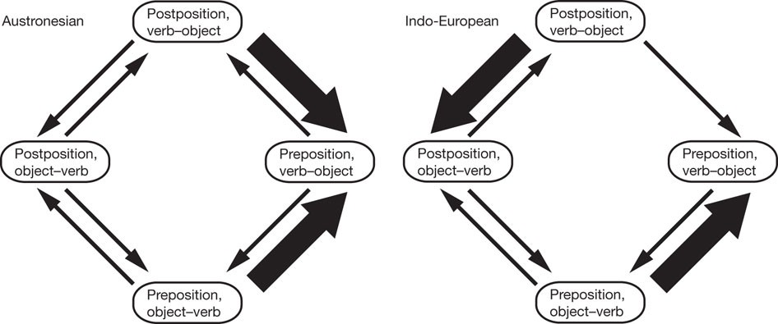
Correlation patterns differ between language families

Slide 39
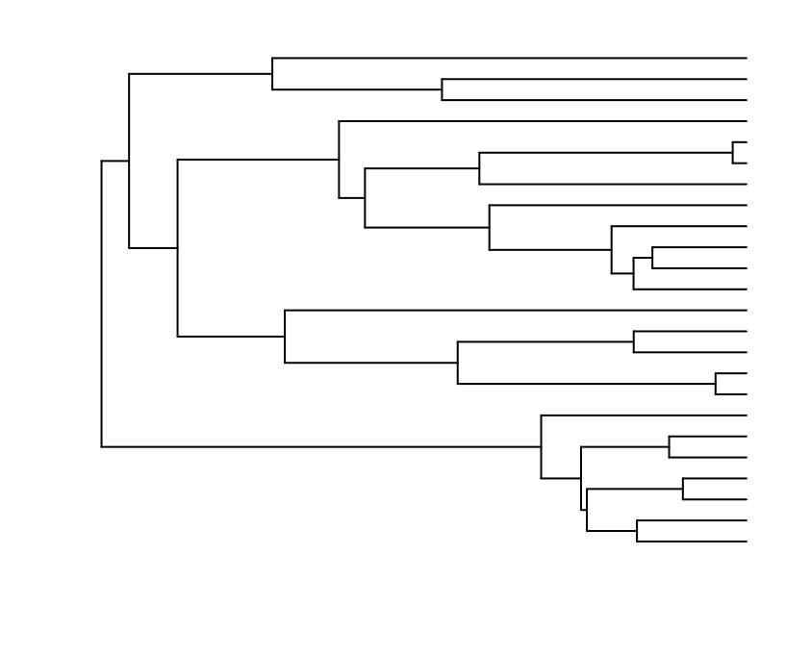
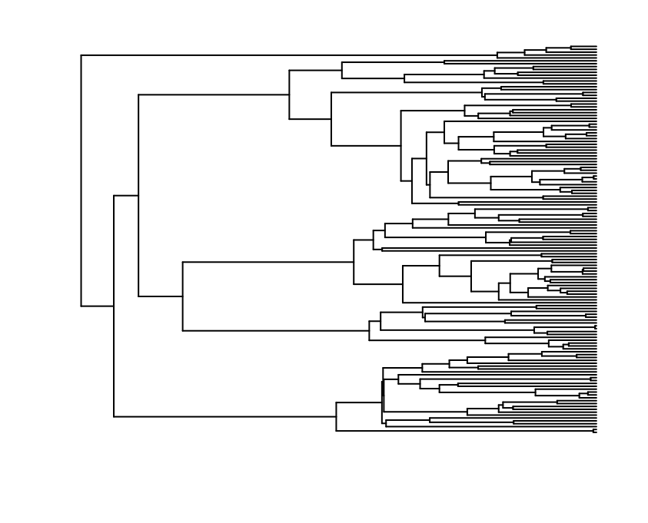
Diversification
Birth=0.5, death=0
Birth=1, death=0

Slide 40
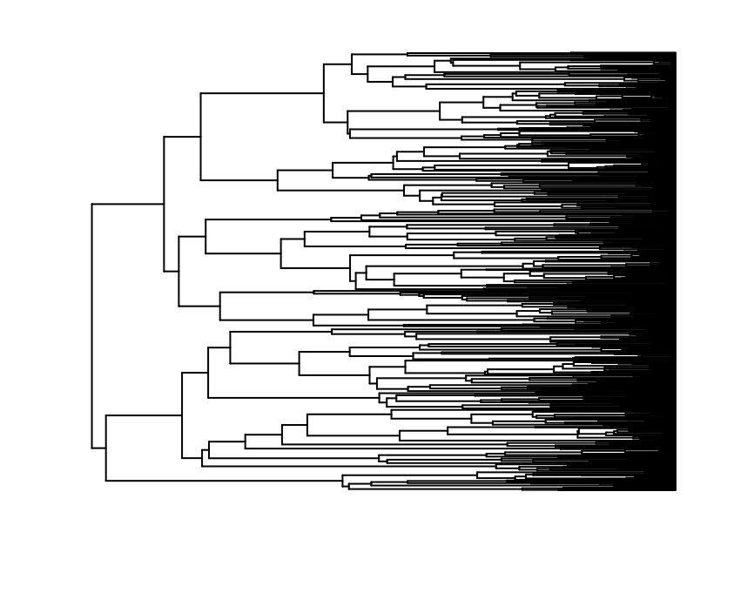
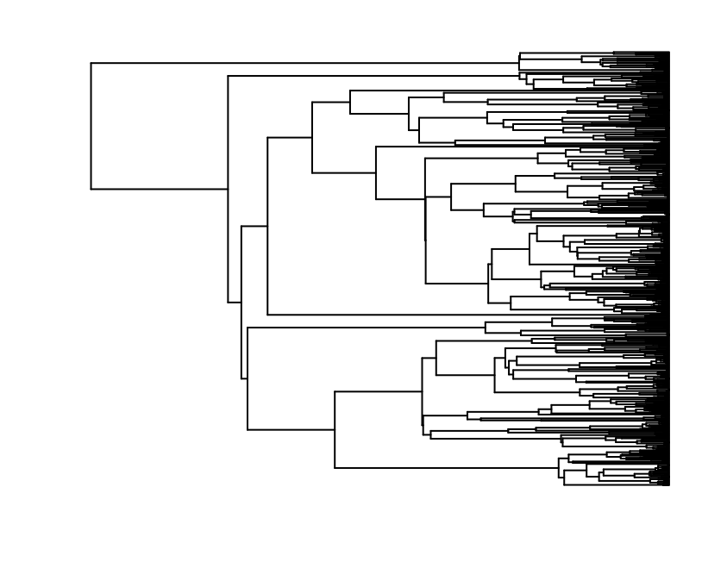
Birth=1, death=0
Birth=5, death=4

Slide 41
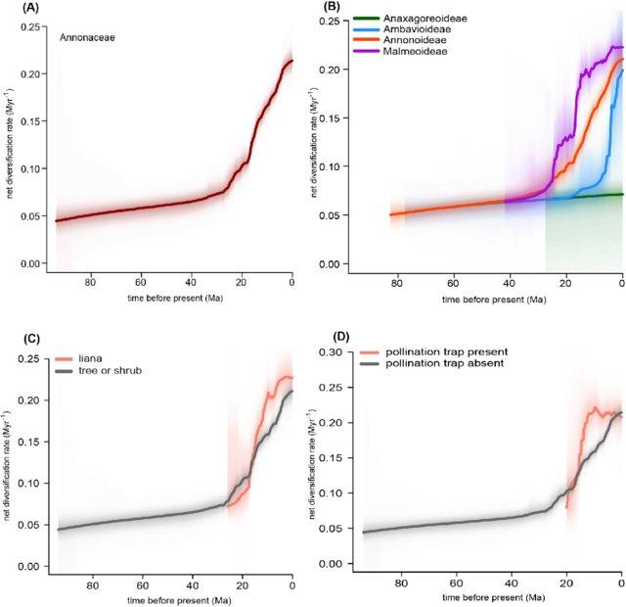
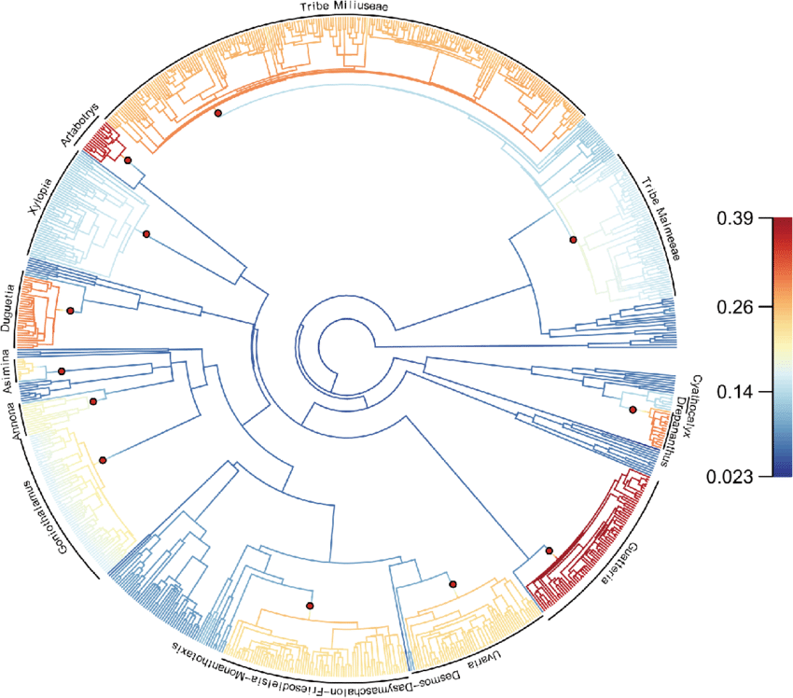
Diversification analysis e.g. BAMM

Slide 42
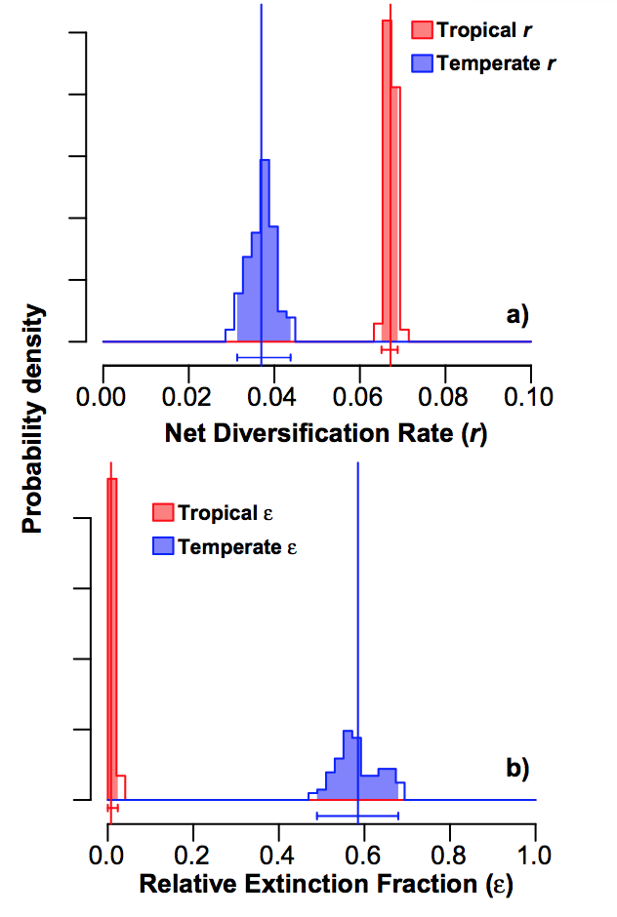
Trait-based diversification

Slide 43
Phylogeography
The study of how lineages are distributed across space
Discrete phylogeography
Locations are treated like traits
Continuous phylogeography
Diffusion on a plane
Diffusion on a sphere
Break-away model
Combines features of Continuous and Discrete Phylogeography

Slide 44
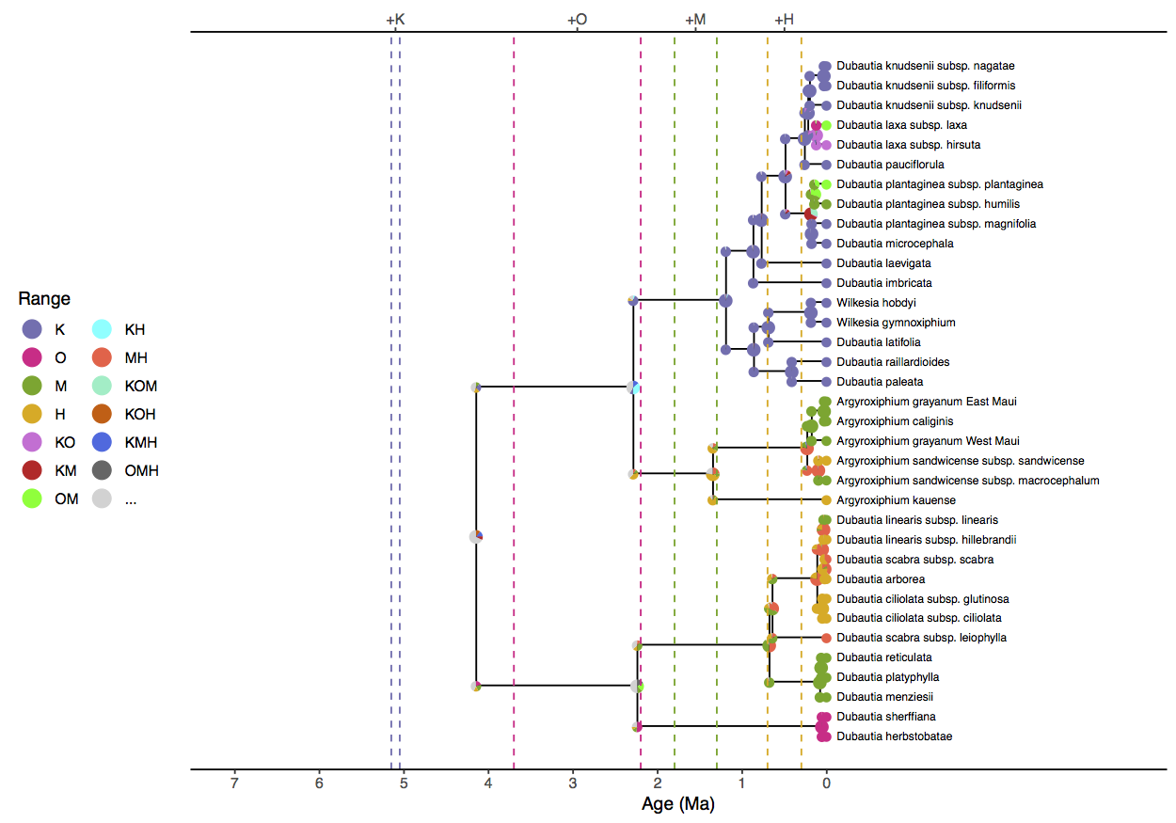
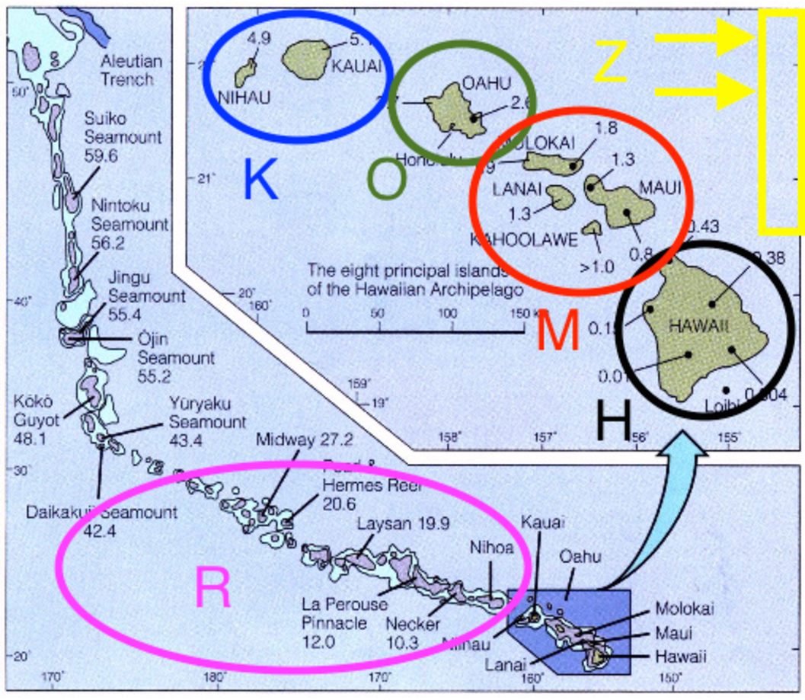
Discrete phylogeography

Slide 45
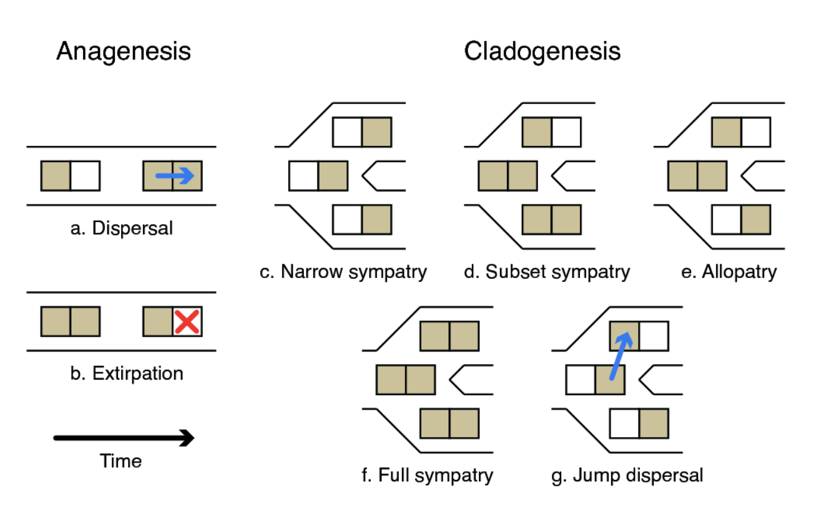
Dispersal-Extinction-Cladogenesis model

Slide 46
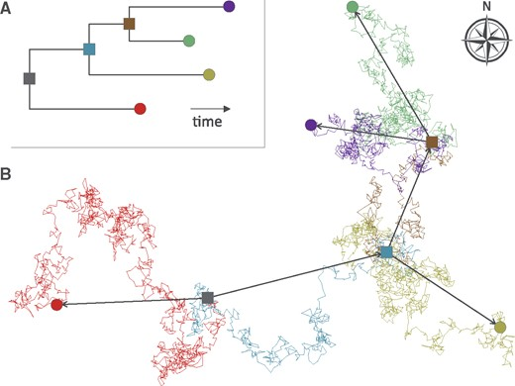
Continuous Phylogeography
Locations are point estimates in Coordinates (Latitude, Longitude)
Migration is modelled as a random walk process

Slide 47
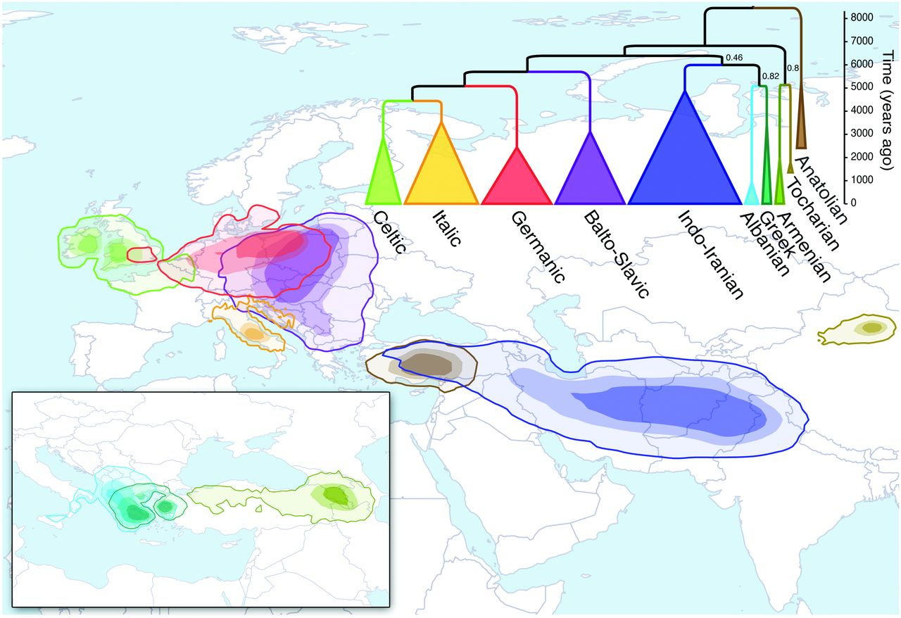
Continuous Phylogeography applied to Indo-European

Slide 48

Continuous Phylogeography applied to Indo-European
Estimated location of nodes
Coloured according to age
Suggests spread out of Anatolia, not Steppe

Slide 49

The break-away model
When a language splits, one lineage remains in place, and the other migrates
Combines features of discrete and continuous Phylogeography

Slide 50

Landscape-aware model

Slide 51

Location data: Pama-Nyungan language family
Bouckaert, R.R., Bowern, C. & Atkinson, Q.D. The origin and expansion of Pama–Nyungan languages across Australia. Nat Ecol Evol 2, 741–749 (2018)

Slide 52

Consensus tree on a map

Slide 53


Slide 54

Consensus tree on a map

Slide 55

Phylogeography of the Bantu languages
Late Holocene Forest Crisis, a drier period, opened a gap in the rainforest (the Sangha River Interval) approx. 2500 BP.
E. Koile,S.J. Greenhill,D.E. Blasi,R. Bouckaert, & R.D. Gray, Phylogeographic analysis of the Bantu language expansion supports a rainforest route, Proc. Natl. Acad. Sci. U.S.A. 119 (32) e2112853119

Slide 56

Timing of Eastern Bantu node pre-dates the Late Holocene Forest Crisis

Slide 57

Phylogeographic analysis suggests a rainforest route

Slide 58

Afternoon tutorial: Quechuan homeland
Continuous biogeography using a spherical difusion model
New data consists of the Latitude and Longitude of each language

